Slide 1
Red Black tree

Slide 2
Red-Black Trees
“Balanced” binary search trees guarantee an O(lgn) running time
Red-black-tree
  Binary search tree with an additional attribute for its nodes: color which can be red or black
  Constrains the way nodes can be colored on any path from the root to a leaf:
    Ensures that no path is more than twice as long as any other path ⇒ the tree is balanced

Slide 3
Example: RED-BLACK-TREE
26
17
41
NIL
NIL
30
47
38
NIL
50
NIL
NIL
NIL
NIL
NIL
For convenience we use a sentinel NIL[T] to represent all the NIL nodes at the leafs
  NIL[T] has the same fields as an ordinary node
  Color[NIL[T]] = BLACK
  The other fields may be set to arbitrary values

Slide 4
Red-Black-Trees Properties
(**Satisfy the binary search tree property**)
Every node is either red or black
The root is black
Every leaf (NIL) is black
If a node is red, then both its children are black
  No two consecutive red nodes on a simple path
  from the root to a leaf
For each node, all paths from that node to descendant leaves contain the same number of black nodes

Slide 5
Black-Height of a Node
h = 4
bh = 2
26
h = 1
bh = 1
h = 3
bh = 2
17
41
NIL
NIL
h = 2
bh = 1
h = 2
bh = 1
30
47
h = 1
bh = 1
38
50
h = 1
bh = 1
NIL
NIL
NIL
NIL
NIL
NIL
Height of a node: the number of edges in the longest path to a leaf
Black-height of a node x: bh(x) is the number of black nodes (including NIL) on the path from x to a leaf,
not counting x

Slide 6
Most important property of
Red-Black-Trees
A red-black tree with n internal nodes
has height at most 2lg(n + 1)
Need to prove two claims first …

Slide 7
Claim 1
Any node x with height h(x) has bh(x) ≥ h(x)/2
Proof
  By property 4, at most h/2 red nodes on the path from the node to a leaf
  Hence at least h/2 are black
h = 4
bh = 2
26
h = 1
bh = 1
h = 3
bh = 2
17
41
NIL
NIL
h = 2
bh = 1
h = 2
bh = 1
30
47
h = 1
bh = 1
38
50
h = 1
bh = 1
NIL
NIL
NIL
NIL
NIL
NIL

Slide 8
Claim 2
The subtree rooted at any node x contains at least 2^{bh(x)} - 1 internal nodes
h = 4
bh = 2
26
h = 1
bh = 1
h = 3
bh = 2
17
41
NIL
NIL
h = 2
bh = 1
h = 2
bh = 1
30
47
h = 1
bh = 1
38
50
h = 1
bh = 1
NIL
NIL
NIL
NIL
NIL
NIL

Slide 9
Claim 2 (cont’d)
Proof: By induction on h[x]
Basis: h[x] = 0 ⇒
x is a leaf (NIL[T]) ⇒
bh(x) = 0 ⇒
# of internal nodes: 2⁰ - 1 = 0
Inductive Hypothesis: assume it is true for h[x]=h-1
x
NIL

Slide 10
Claim 2 (cont’d)
Inductive step:
Prove it for h[x]=h
Let bh(x) = b, then any child y of x has:
  bh (y) =
  bh (y) =
b (if the child is red), or
b - 1 (if the child is black)
bh = 2
x
26
bh = 2
y₁
y₂
bh = 1
17
41
NIL
NIL
30
47
NIL
38
NIL
50
NIL
NIL

Slide 11
Claim 2 (cont’d)
Using inductive hypothesis, the number of internal nodes for each child of x is at least:
2^{bh(x) - 1} - 1
The subtree rooted at x contains at least:
(2^{bh(x) - 1} – 1) + (2^{bh(x) - 1} – 1) + 1 =
2 · (2^{bh(x) - 1} - 1) + 1 =
2^{bh(x)} - 1 internal nodes
x
h
l
r
h-1
bh(l)≥bh(x)-1
bh(r)≥bh(x)-1

Slide 12
Height of Red-Black-Trees (cont’d)
height(root) = h
bh(root) = b
root
Lemma: A red-black tree with n internal nodes has height at most 2lg(n + 1).
Proof:
n
Add 1 to both sides and then take logs:
n + 1 ≥ 2^{b} ≥ 2^{h/2}
lg(n + 1) ≥ h/2 ⇒
h ≤ 2 lg(n + 1)
≥ 2^{b} - 1
≥ 2^{h/2} - 1
l
r
number n
of internal
nodes
since b ≥ h/2

Slide 13
Operations on Red-Black-Trees
The non-modifying binary-search-tree operations MINIMUM, MAXIMUM, SUCCESSOR, PREDECESSOR, and SEARCH run in O(h) time
  They take O(lgn) time on red-black trees
What about TREE-INSERT and TREE-DELETE?
  They will still run on O(lgn)
  We have to guarantee that the modified tree will still be a red-black tree

Slide 14
INSERT
INSERT: what color to make the new node?
Red? Let’s insert 35!
  Property 4 is violated: if a node is red, then both its children are black
Black? Let’s insert 14!
  Property 5 is violated: all paths from a node to its leaves contain the same number of black nodes
26
17
41
30
47
38
50

Slide 15
DELETE
26
17
41
30
47
38
50
DELETE: what color was the
node that was removed? Black?
Every node is either red or black
The root is black
Every leaf (NIL) is black
If a node is red, then both its children are black
For each node, all paths from the node to descendant leaves contain the same number of black nodes
OK!
Not OK! If removing the root and the child that replaces it is red
OK!
Not OK! Could change the
black heights of some nodes
Not OK! Could create
two red nodes in a row

Slide 16
Rotations
Operations for re-structuring the tree after insert and delete operations on red-black trees
Rotations take a red-black-tree and a node within the tree and:
  Together with some node re-coloring they help restore the red-black-tree property
  Change some of the pointer structure
  Do not change the binary-search tree property
Two types of rotations:
  Left & right rotations

Slide 17
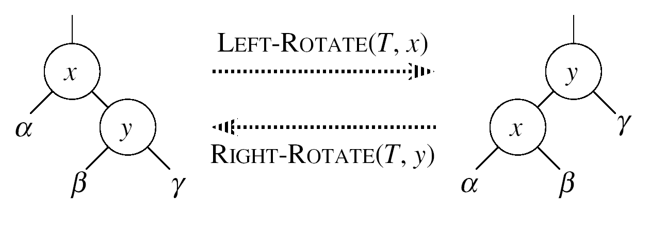
Left Rotations
Assumptions for a left rotation on a node x:
  The right child of x (y) is not NIL
Idea:
  Pivots around the link from x to y
  Makes y the new root of the subtree
  x becomes y’s left child
  y’s left child becomes x’s right child

Slide 18
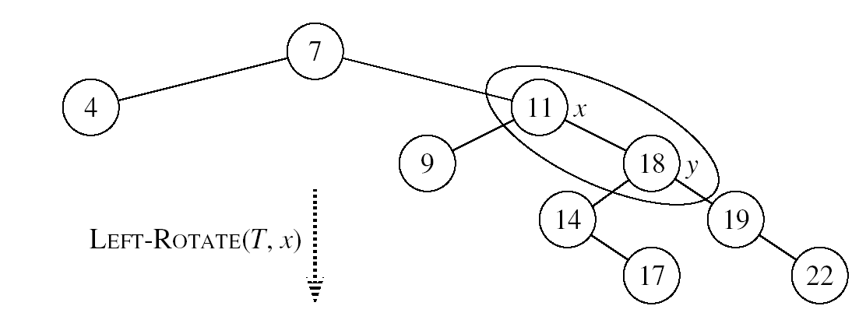
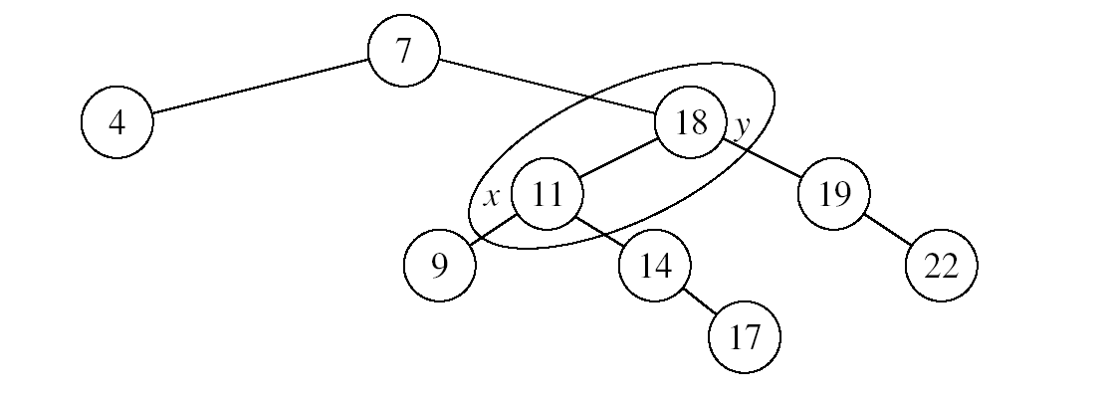
Example: LEFT-ROTATE

Slide 19
LEFT-ROTATE(T, x)
y ← right[x] ►Set y
right[x] ← left[y] ► y’s left subtree becomes x’s right subtree
if left[y] ≠ NIL
then p[left[y]] ← x ► Set the parent relation from left[y] to x
p[y] ← p[x] ► The parent of x becomes the parent of y
if p[x] = NIL
then root[T] ← y
else if x = left[p[x]]
then left[p[x]] ← y
else right[p[x]] ← y
left[y] ← x ► Put x on y’s left
p[x] ← y ► y becomes x’s parent

Slide 20
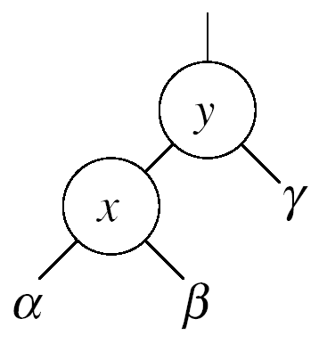
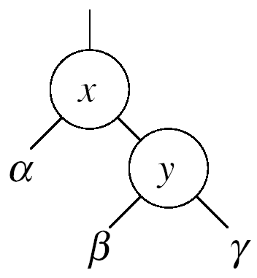


Right Rotations
Assumptions for a right rotation on a node x:
  The left child of y (x) is not NIL
Idea:
  Pivots around the link from y to x
  Makes x the new root of the subtree
  y becomes x’s right child
  x’s right child becomes y’s left child

Slide 21
Insertion
Goal:
  Insert a new node z into a red-black-tree
Idea:
  Insert node z into the tree as for an ordinary binary search tree
  Color the node red
  Restore the red-black-tree properties
    Use an auxiliary procedure RB-INSERT-FIXUP

Slide 22
RB Properties Affected by Insert
OK!
Every node is either red or black
The root is black
Every leaf (NIL) is black
If a node is red, then both its children are black
For each node, all paths
from the node to descendant
leaves contain the same number
of black nodes
If z is the root
⇒ not OK
OK!
If p(z) is red ⇒ not OK
z and p(z) are both red
OK!
26
17
41
38
47
50

Slide 23
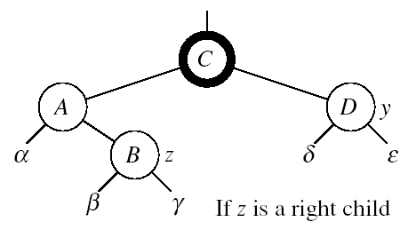
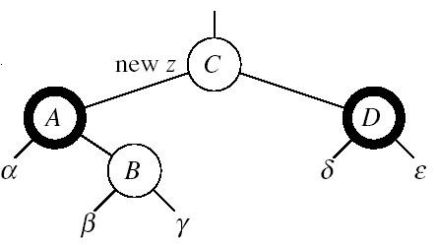
RB-INSERT-FIXUP – Case 1
z’s “uncle” (y) is red
Idea: (z is a right child)
p[p[z]] (z’s grandparent) must be black: z and p[z] are both red
Color p[z] black
Color y black
Color p[p[z]] red
z = p[p[z]]
  Push the “red” violation up the tree

Slide 24
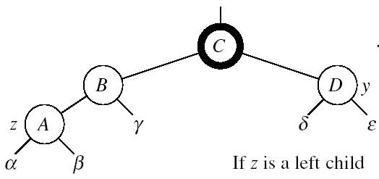
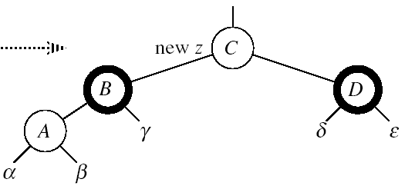
RB-INSERT-FIXUP – Case 1
z’s “uncle” (y) is red
Idea: (z is a left child)
p[p[z]] (z’s grandparent) must be black: z and p[z] are both red
color p[z] ← black
color y ← black
color p[p[z]] ← red
z = p[p[z]]
  Push the “red” violation up the tree

Slide 25
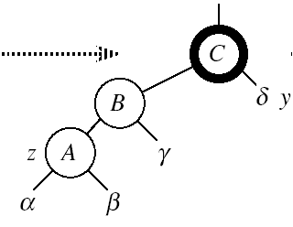
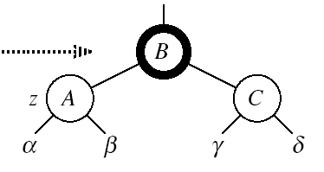
RB-INSERT-FIXUP – Case 3
Case 3:
z’s “uncle” (y) is black
z is a left child
Idea:
color p[z] ← black
color p[p[z]] ← red
RIGHT-ROTATE(T, p[p[z]])
No longer have 2 reds in a row
p[z] is now black
Case 3

Slide 26
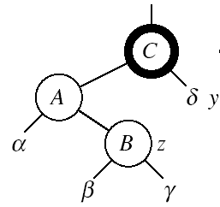
RB-INSERT-FIXUP – Case 2
Case 2:
z’s “uncle” (y) is black
z is a right child
Idea:
z ← p[z]
LEFT-ROTATE(T, z)
⇒ now z is a left child, and both z and p[z] are red ⇒ case 3
Case 2
Case 3

Slide 27
RB-INSERT-FIXUP(T, z)
while color[p[z]] = RED
do if p[z] = left[p[p[z]]]
then y ← right[p[p[z]]]
if color[y] = RED
then Case1
else if z = right[p[z]]
then Case2
Case3
else (same as then clause with “right” and “left” exchanged)
color[root[T]] ← BLACK
The while loop repeats only when
case1 is executed: O(lgn) times
Set the value of x’s “uncle”
We just inserted the root, or
The red violation reached the root

Slide 28
Example
Insert 4
11
Case 1
11
Case 2
2
14
2
14
y
1
7
7
z
15
1
15
5
8
y
5
8
z and p[z] are both red
z’s uncle y is red
z and p[z] are both red
z’s uncle y is black
z is a right child
z
4
4
11
7
Case 3
z
7
14
y
2
11
z
2
8
15
1
5
8
14
1
5
z and p[z] are red
z’s uncle y is black
z is a left child
4
15
4

Slide 29
RB-INSERT(T, z)
26
17
41
30
47
Initialize nodes x and y
Throughout the algorithm y points
to the parent of x
y ← NIL
x ← root[T]
while x ≠ NIL
do y ← x
if key[z] < key[x]
then x ← left[x]
else x ← right[x]
p[z] ← y
38
50
Go down the tree until
reaching a leaf
At that point y is the
parent of the node to be
inserted
Sets the parent of z to be y

Slide 30
RB-INSERT(T, z)
26
17
41
if y = NIL
then root[T] ← z
else if key[z] < key[y]
then left[y] ← z
else right[y] ← z
left[z] ← NIL
right[z] ← NIL
color[z] ← RED
RB-INSERT-FIXUP(T, z)
30
47
The tree was empty:
set the new node to be the root
38
50
Otherwise, set z to be the left or
right child of y, depending on whether the inserted node is smaller or larger than y’s key
Set the fields of the newly added node
Fix any inconsistencies that could have
been introduced by adding this new red
node

Slide 31
Analysis of RB-INSERT
Inserting the new element into the tree O(lgn)
RB-INSERT-FIXUP
  The while loop repeats only if CASE 1 is executed
  The number of times the while loop can be executed is O(lgn)
Total running time of RB-INSERT: O(lgn)

